Slide 1
DSC530 Final Project
By Vineet Mehta

Slide 2
Data base:
I am using the database “NCHS - Leading Causes of Death: United States” (url:https://catalog.data.gov/dataset/nchs-leading-causes-of-death-united-states).
The database contains age-adjusted death rates for the 10 leading causes of death in the United States beginning in 1999.
Data are based on information from all resident death certificates filed in the 50 states and the District of Columbia using demographic and medical characteristics. Age-adjusted death rates (per 100,000 population) are based on the 2000 U.S. standard population. Populations for computing death rates after 2010 are postcensal estimates based on the 2010 census, estimated as of July 1, 2010. Rates for census years are based on populations enumerated in the corresponding censuses. Rates for non-census years before 2010 are revised using updated intercensal population estimates and may differ from published rates.

Slide 3
Selection and Description of Variables
From the dataset, we select five variables for detailed analysis:
Year: The year the data was recorded.
Cause Name: The readable name for the cause of death.
State: The state in which the deaths were recorded.
Deaths: The number of deaths attributed to the cause.
Age-adjusted Death Rate: The death rate per 100,000 population, adjusted for age.

Slide 4
Histograms and Descriptive Characteristics
I will generate histograms for the variables "Deaths" and "Age-adjusted Death Rate", as these are quantitative variables suitable for such analysis. I will also calculate their mean, mode, and spread (standard deviation), and observe the tails of their distributions.

Slide 5
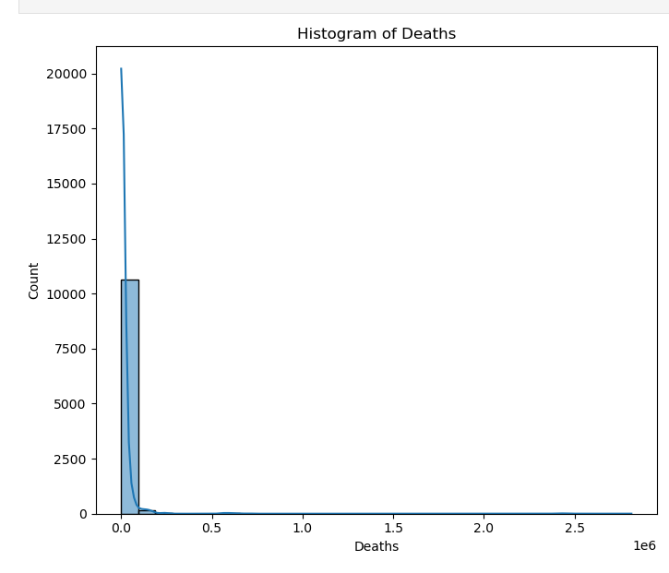
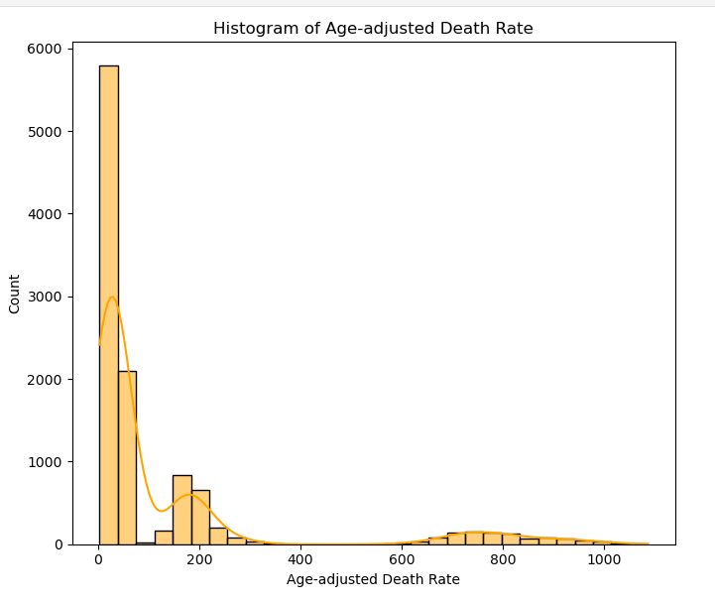
Regression Analysis
Histograms and descriptive statistics for the "Deaths" and "Age-adjusted Death Rate" variables to gain initial insights into their distributions.

Slide 6

Handling Outliers
The presence of outliers in both "Deaths" and "Age-adjusted Death Rate" can be attributed to rare but severe events or differences in population size among states. For analytical purposes, outliers might be examined separately to understand their causes or potentially excluded if focusing on typical patterns within the data.

Slide 7
Thank You

